Slide 1
Sets in Python programming language
Hrishikesh Deshpande
ADS

Slide 2
What is set ?
In Python sets are written with curly brackets.
Important properties of sets
It Can store different data types
Duplicate values are not allowed in sets.
Order is not retained.
Indexing and slicing is not possible in sets operations.

Slide 3
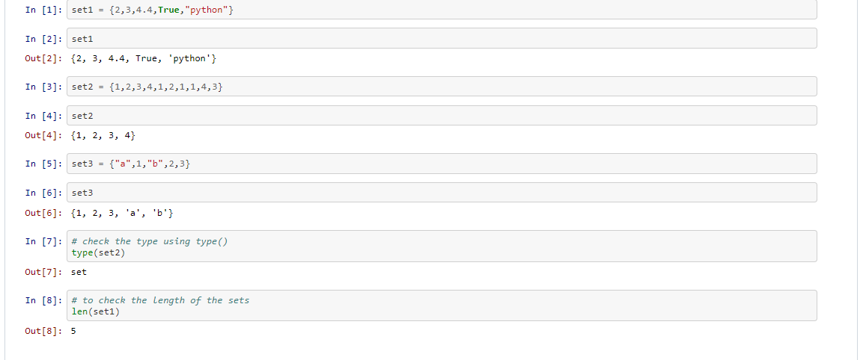
SET :

Slide 4
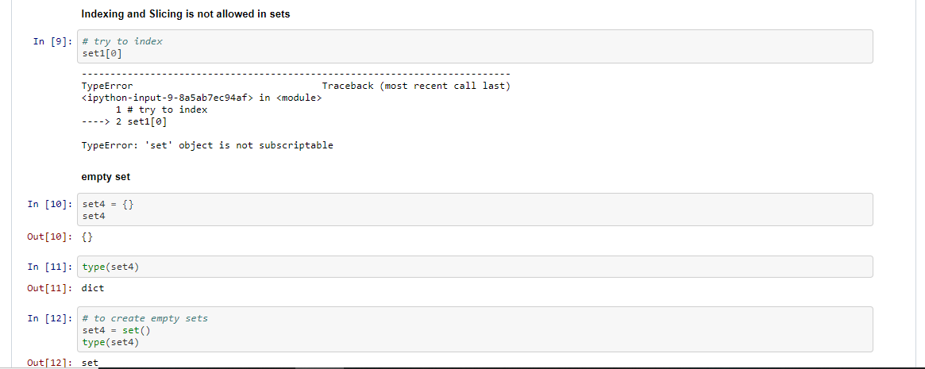
Indexing is not allowed :

Slide 5
Mutability :
Mutability :
Once set is created you can add and remove the elements from the set, but you cannot modify the existing elements in a set

Slide 6
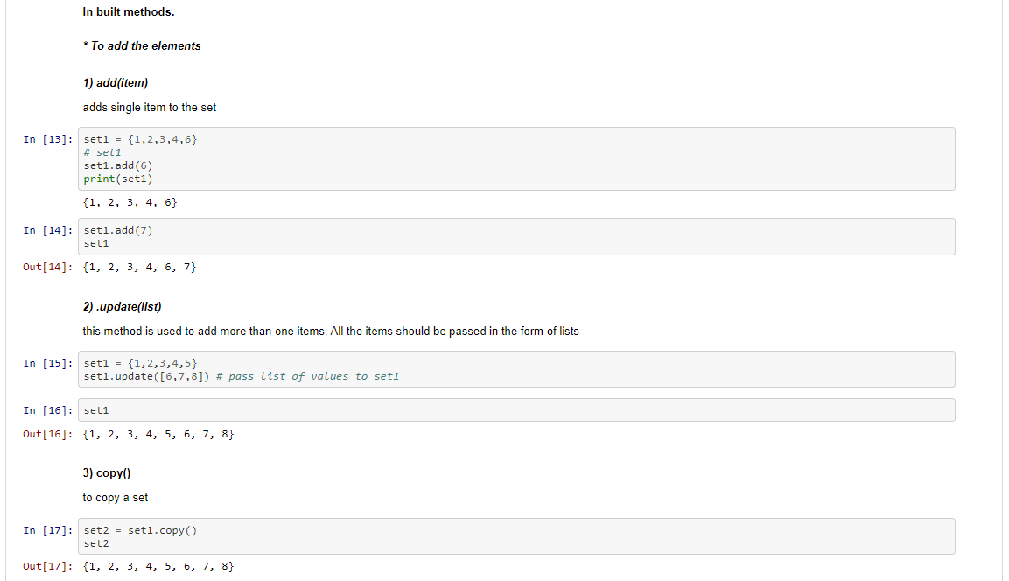
Built in methods : 1.Add 2. update 3. Copy

Slide 7
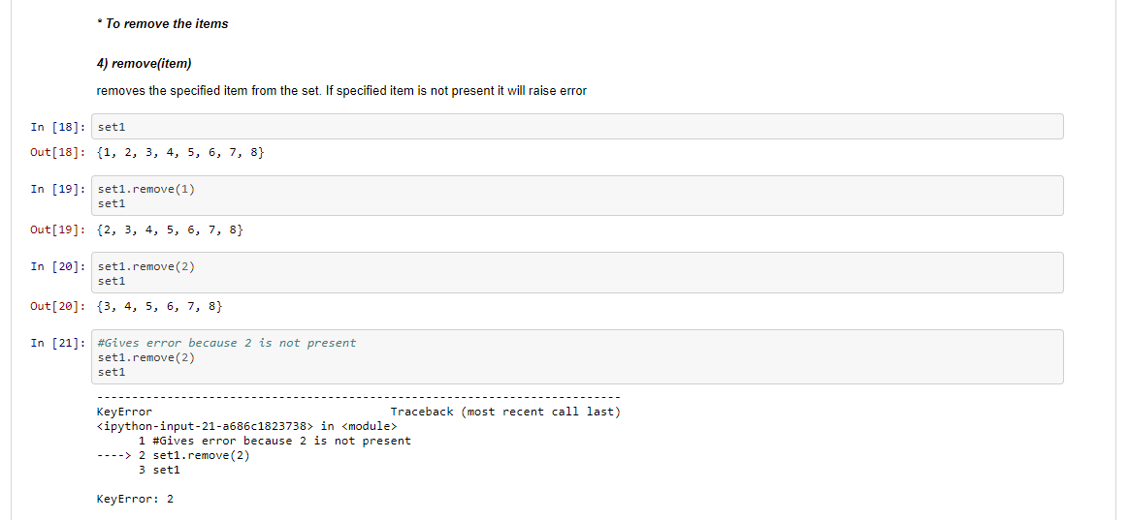
4. Remove() :

Slide 8
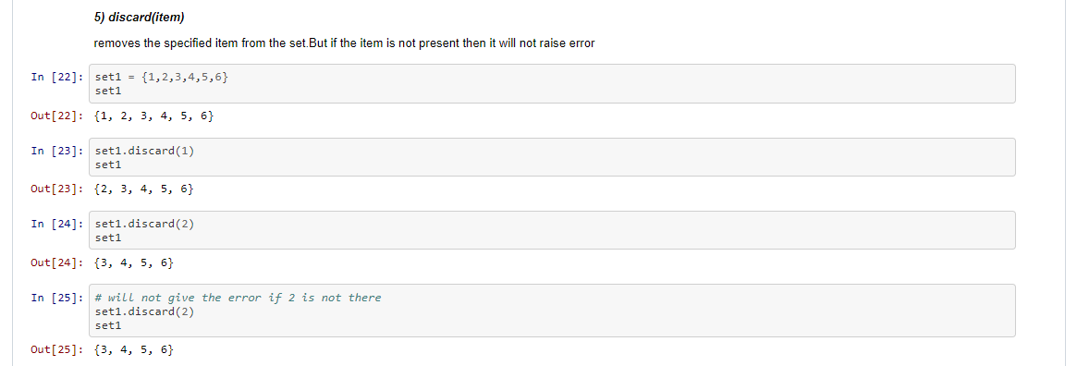
5. Discard() :

Slide 9
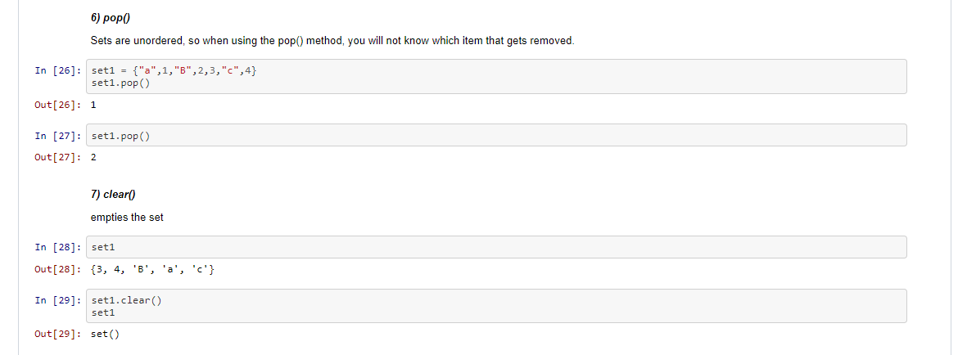
6.Pop() 7. clear()

Slide 10
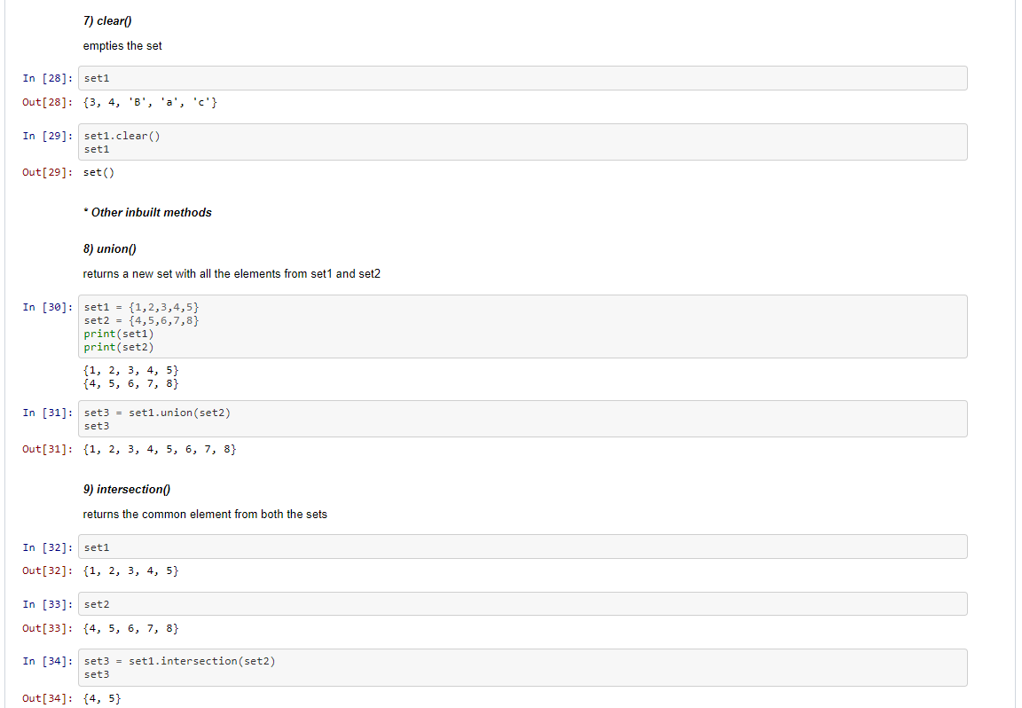
Other methods : 8.union() 9.intersection()

Slide 11
10. Difference method :
The difference() method returns a set that contains the difference between two sets.
Meaning: The returned set contains items that exist only in the first set, and not in both sets.
x = {"apple", "banana", "cherry"} y = {"google", "microsoft", "apple"} z = x.difference(y) = {“cherry” , “banana”} print(z)
And if :
z = y.difference(x) = {"google", "microsoft“}

Slide 12
11. Symmetric difference method :
The symmetric_difference() method returns a set that contains all items from both set, but not the items that are present in both sets.
Meaning: The returned set contains a mix of items that are not present in both sets.
x = {"apple", "banana", "cherry"} y = {"google", "microsoft", "apple"} z = x.symmetric_difference(y) print(z) = {"banana", "cherry“ , "google", "microsoft“ }

Slide 13
THANK YOU !!!

